Slide 1

GUAN LEE HOE
Strategies for Enhancing Brand Presence and Generating Leads

Slide 2

Marketing Plan
Business Objective: To increase brand awareness
Target Market: SMEs who are relocating or new SMEs who are opening new office
Market Needs: Industry Experts, efficient and follow-ups on maintenance
Product Overview: A broad range of products to meet diverse needs within a single supplier
Market Strategy: Optimise website and SEO ranking. SEM and implement Social Media posts
Digital Marketing Strategies

Slide 3
PERSONA
Name: Sam Tan
Age: 38
Occupation: Owner of a Medium-Sized Retail Store
Education Level: Bachelor’s Degree in Business Administration
Location: Singapore
Marital Status: Married with two children
Income: SGD 100,000 annually

Slide 4
Pain Points | Motivations
Transition Management: Difficulty in relocating and setting up a new space, including installation of essential systems like air conditioning. Minimizing Downtime: Concerned about minimizing operational disruptions during the move. Budget Constraints: Managing costs associated with relocation, including installation of new systems | Seamless Transition: Ensure a smooth and efficient move to the new space with minimal interruption to business operations. Comfort and Efficiency: Quickly establish a comfortable environment in the new location to support employee productivity and customer satisfaction. Cost Management: Find cost-effective solutions that fit within the budget allocated for the relocation.
Challenges | Core Values and Beliefs
Coordination of Services: Difficulty coordinating multiple service providers during the relocation process, including AC installation. Time Constraints: Limited time to oversee the installation process due to the busy schedule of managing the move. Reliability of Providers: Need for reliable and prompt service providers who can meet tight deadlines | Coordination of Services: Difficulty coordinating multiple service providers during the relocation process, including AC installation. Time Constraints: Limited time to oversee the installation process due to the busy schedule of managing the move. Reliability of Providers: Need for reliable and prompt service providers who can meet tight deadlines

Slide 5
Service Needs and Preference
Online Behaviour | Research-Oriented: Spends time researching service providers online. Seeks companies with good reviews, detailed service descriptions, and strong portfolios. Website Navigation: Prefers easy-to-navigate websites with clear information about services, pricing, and contact details. Values websites that provide case studies or testimonials.
Communication Channels | Email: For detailed, professional correspondence and updates. Messenging Providers(Whatsapp): For follow-ups and trivial queries LinkedIn For industry insights, networking, and content engagement.

Slide 6
Service Needs and Preference
Service Expectations | Professionalism: Expects high standards of professionalism and customer service with courteous and knowledgeable staff. Quality of Work: Values high-quality workmanship and attention to detail, using quality materials and best practices. Reliability: Requires on-time project completion with minimal disruption and regular updates on progress. After-Sales Support: Needs reliable after-sales support, including maintenance services and quick resolution of post-installation issues.

Slide 7
Decision Making Process
Information Sources | 1. Search Engine: Mainstream use of Google for anything that is related to his interest. 2. Social Media: Joining groups/pages, related to Office/Commercial construction works

Slide 8

Website Analysis

Slide 9
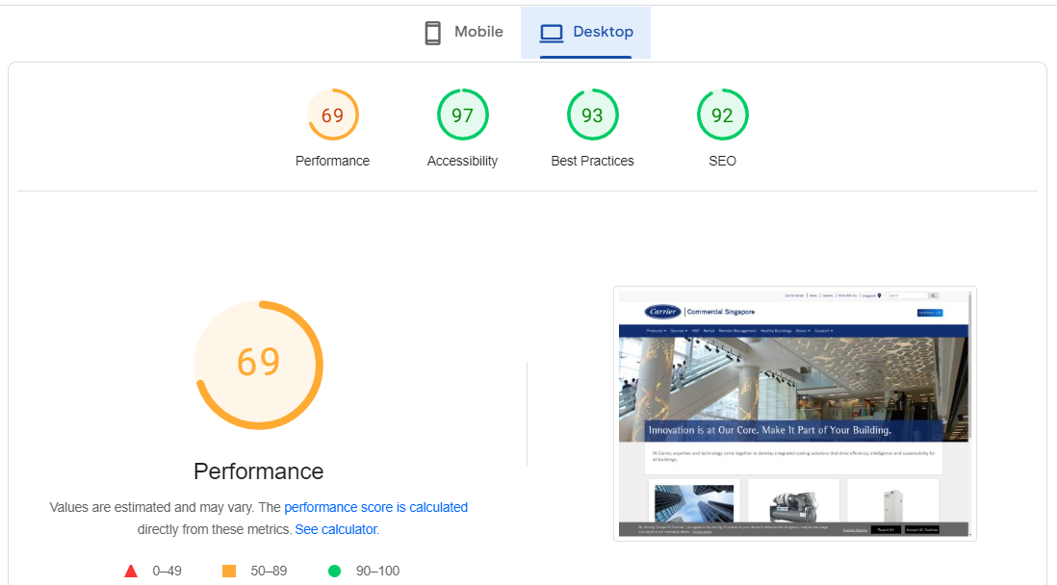
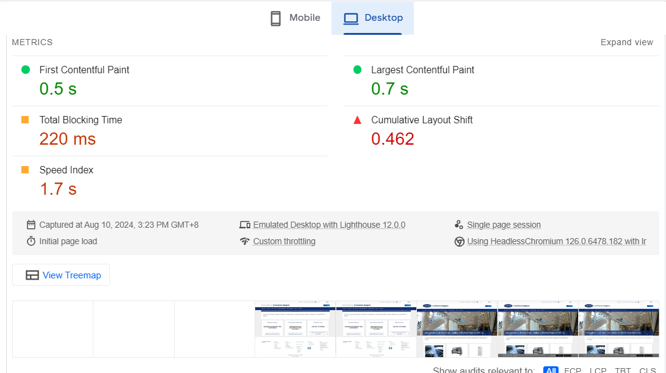
Carrier(desktop)

Slide 10
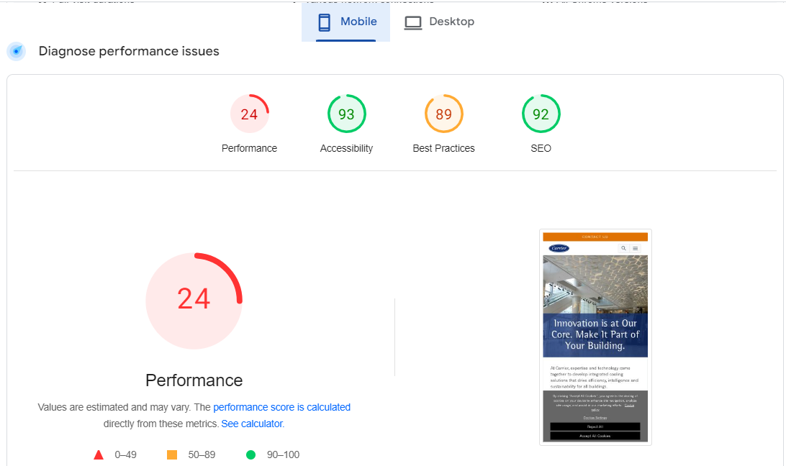
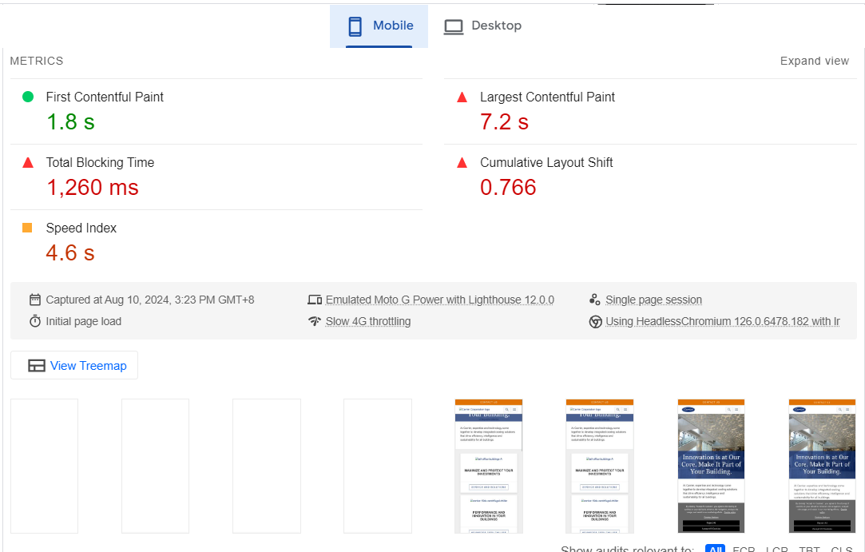
Carrier(Mobile)

Slide 11
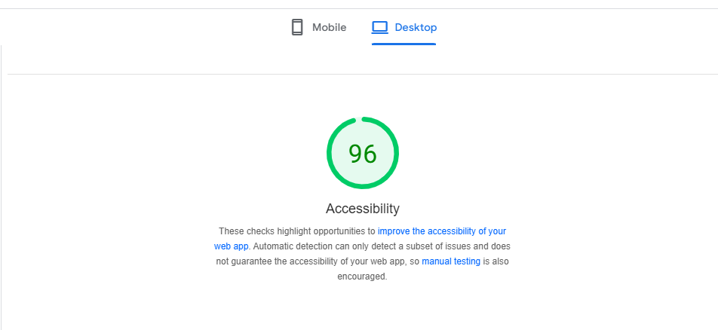
Guan Lee Hoe(Desktop)

Slide 12
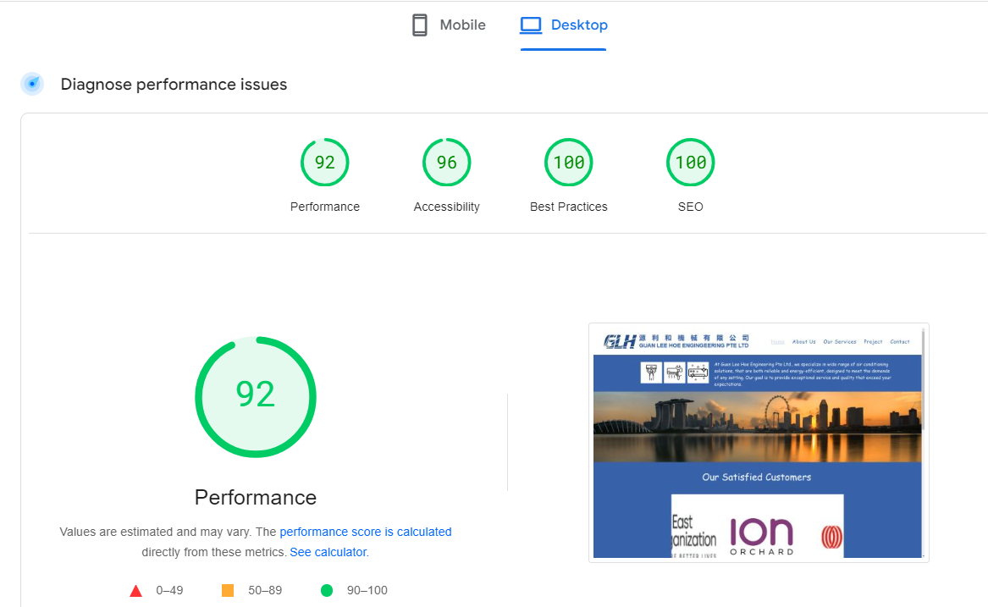
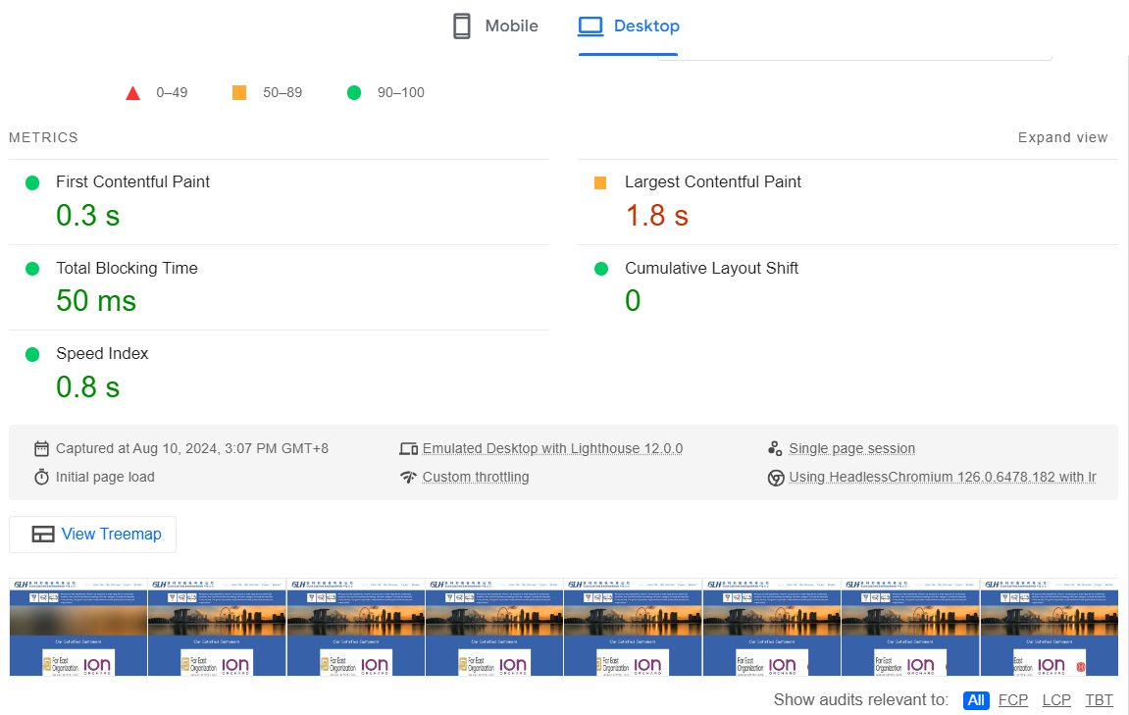
Guan Lee Hoe(Desktop)

Slide 13
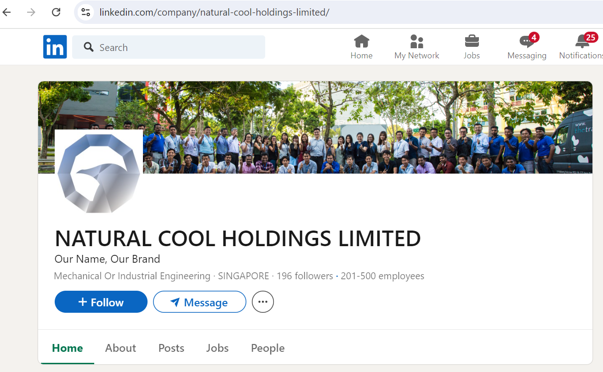
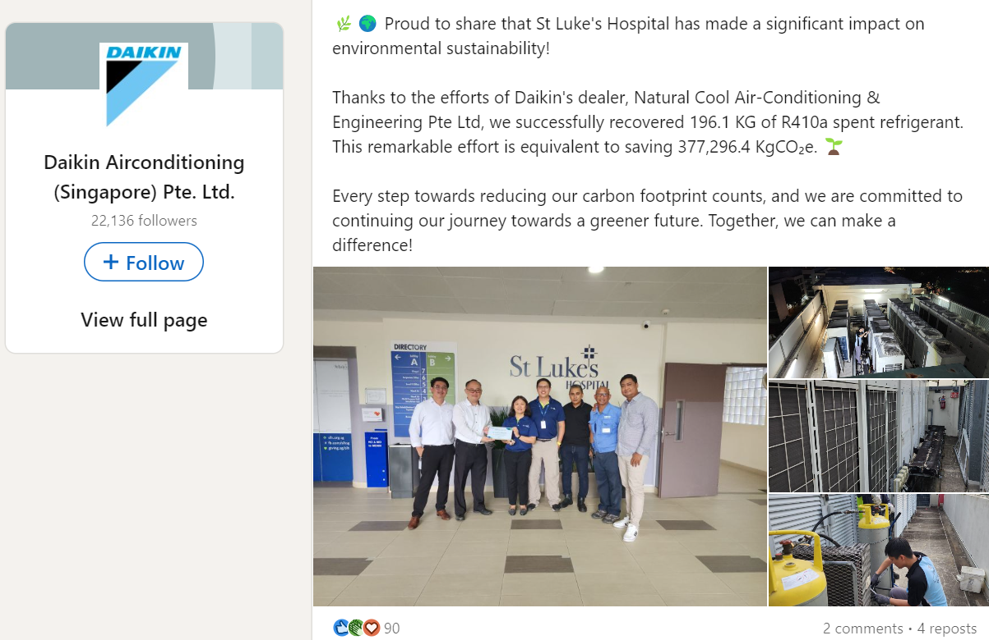
Competitor Analysis(Social Media)
NATURAL COOL(LinkedIn)
LinkedIn: 196 followers.
Last post was 1 month ago. Which was a link to one of their partners with 90 reactions, 2 comments and 4 reposts

Slide 14
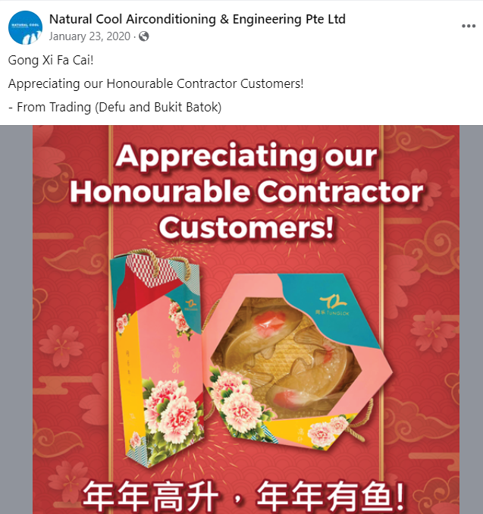
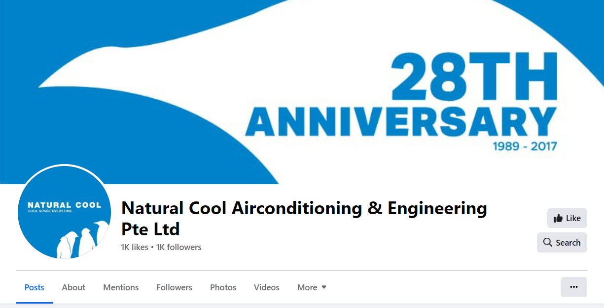
Natural Cool (Facebook)
Not updated
Not up to date on FB post. Last post was in 2020

Slide 15
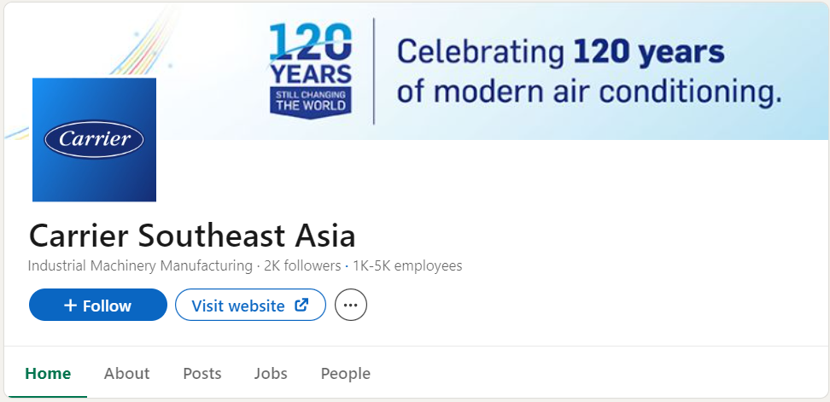
Carrier (LinkedIn)
Carrier has a regional LinkedIn Account only, not a specific local account.
2,000 followers
7 posts this past month

Slide 16
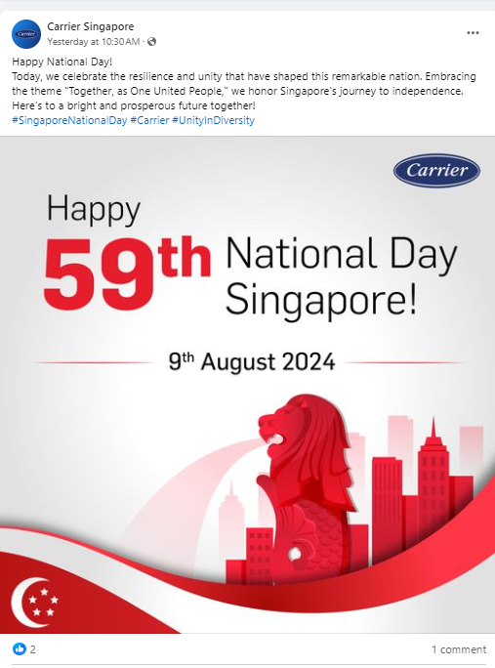
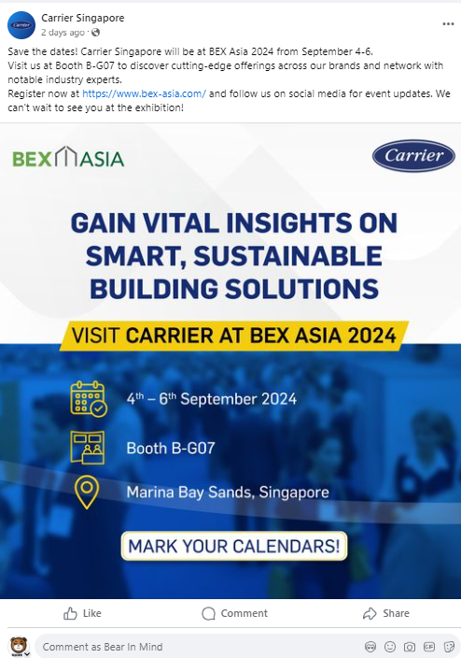
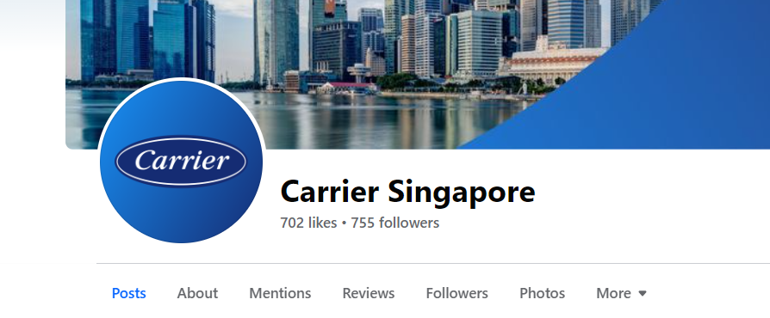
Carrier (Facebook)
702 Likes, 755 followers.
Quite active in postings on FB.
6 posts in July and 2 in August
Not running Facebook Ads

Slide 17
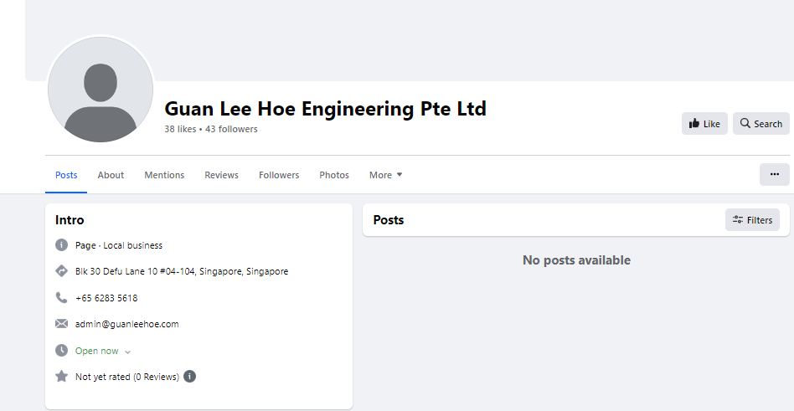
GUAN LEE HOE (Facebook)
38 Likes and 43 Followers.
No images, no posts
Not active

Slide 18
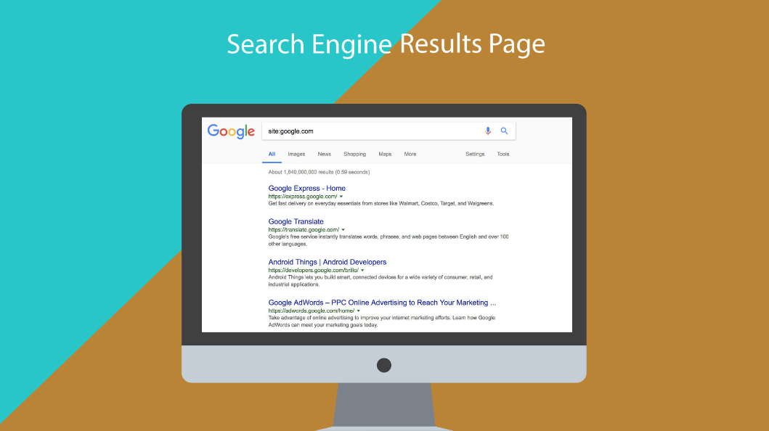
Search Engine Marketing Analysis

Slide 19
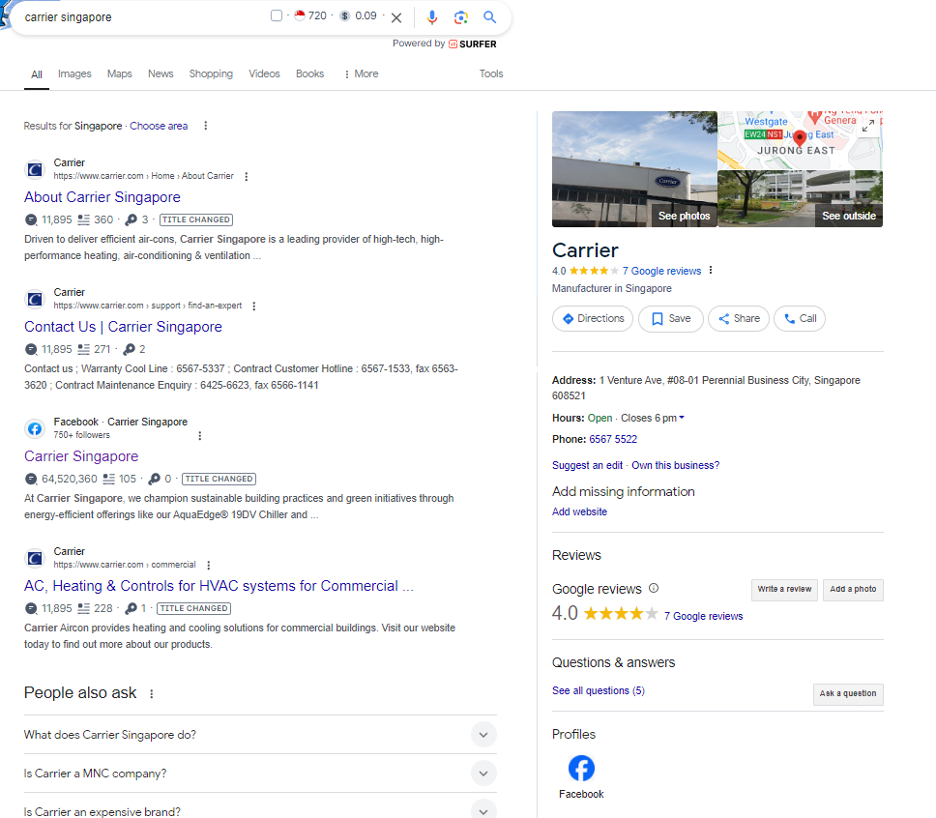
Carrier
Missing info
No SEM
7 Google Reviews with an average of 4 Star rating.

Slide 20
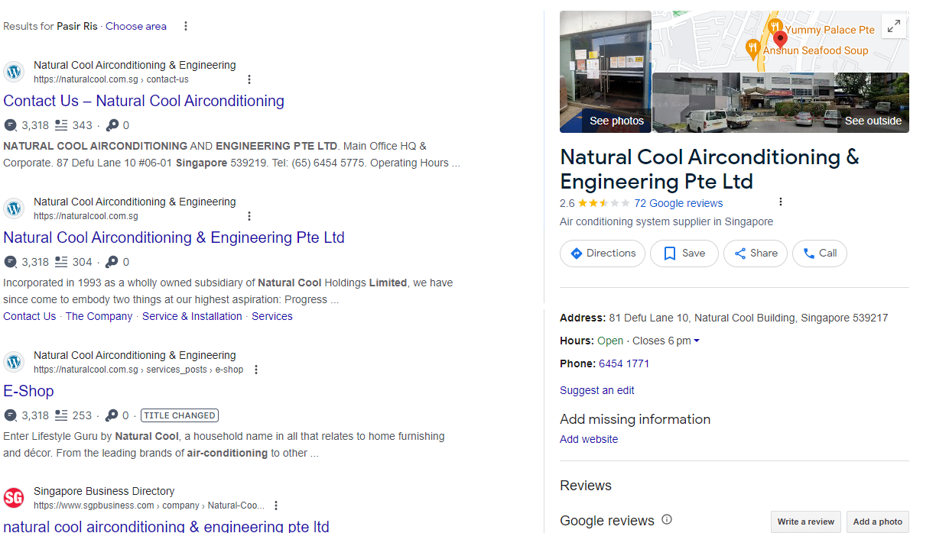
Natural Cool
No SEM
Rated 2.6 Stars from 72 reviews.

Slide 21
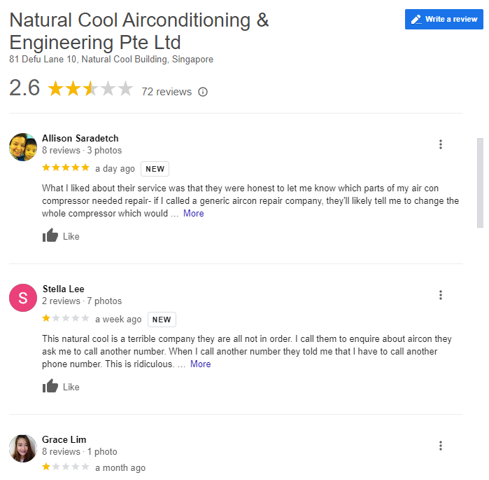
Only one 5 Star ratings out of the last ten reviews. The rest of the reviews(9) were rated 1 star. Most of their low reviews are about their after sales service

Slide 22
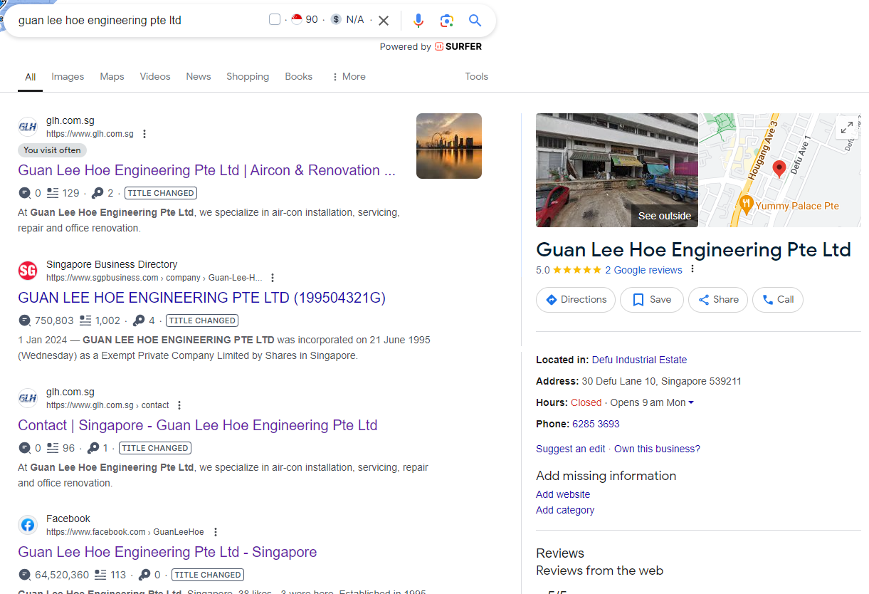
Guan Lee Hoe
5 star rating of 2 reviews

Slide 23
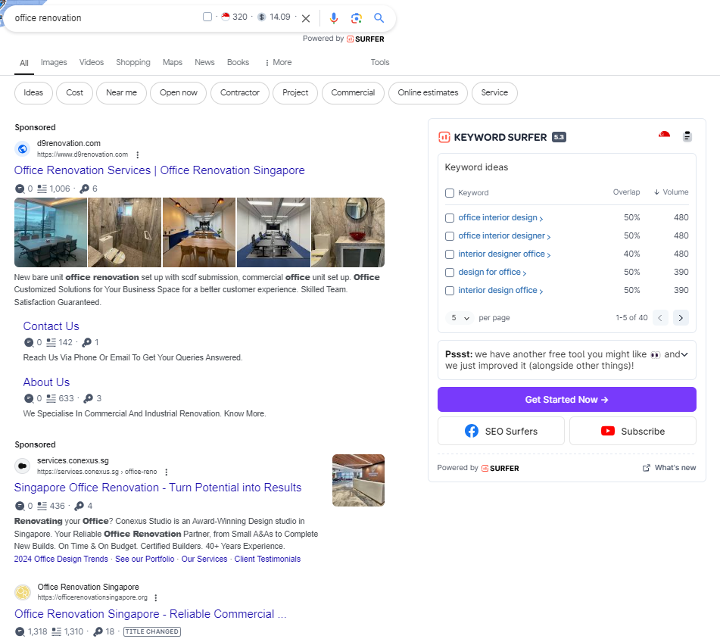
Search Engine Searches for “Office Renovation”
There are only two paid ads at the top of the search results.

Slide 24
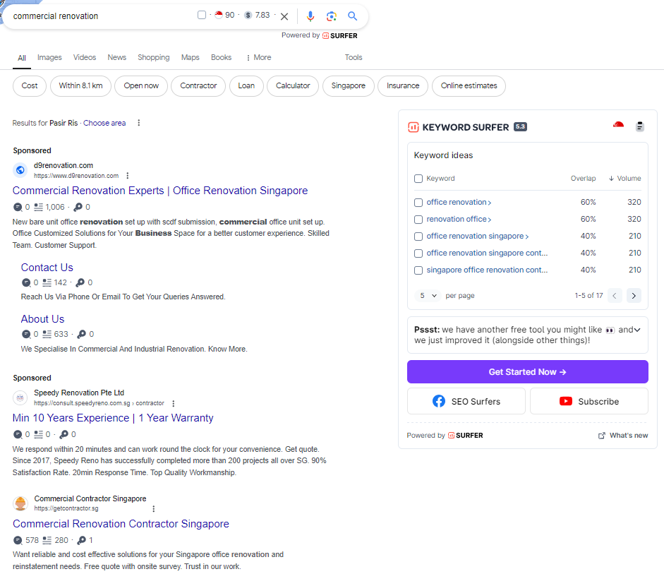
Search Engine Searches for “Commercial Renovation”
There are only two paid ads at the top of the search results.

Slide 25
SWOT analysis for Guan Lee Hoe
Strengths | Weaknesses
Expertise: Deep knowledge or specialized skills in their field. Reputation: Established credibility and trust within their industry or market. Local Knowledge: Strong understanding of the Singaporean market and business environment. Innovation: Ability to offer unique products or services that differentiate from competitors. | Market Reach: Possible limitations in expanding beyond local or regional markets. Dependence on Key Clients: High reliance on a few major clients or partners
Opportunities | Threats
Market Expansion: Potential to grow into new markets. Strategic Partnerships: Potential to form alliances or partnerships that could lead to new opportunities. Trends: Ability to capitalize on emerging trends or shifts in consumer behavior | Economic Fluctuations: Vulnerability to economic downturns or changes in market conditions. Regulatory Changes: Potential impact of new regulations or changes in compliance requirements. Market Saturation: Risk of oversaturation in the current market leading to reduced margins or growth.

Slide 26
Marketing Prioritization
Prioritize (Must Do Now!) | Medium (To Consider)
Social Media Engagement: Engage actively on platforms like LinkedIn and Instagram to build relationships and share valuable content. SEO Optimization: Improve your website’s SEO with keyword-rich content and technical optimizations | Paid Advertising: Invest in targeted ads on platforms such as Google Ads or LinkedIn Ads to reach a larger audience. Advanced Analytics Tools: Invest in sophisticated marketing technology or tools for better insights and optimization
High Impact
Investigate | Avoid
Generic Social Media Posts: Basic posts without a targeted strategy or engagement efforts | Expensive Print Campaigns: High-cost print ads with limited targeting or measurable impact
Low Impact
Low Cost to Execute
High Cost to Execute

Slide 27
Marketing Funnel
Attention
01
SEM- Google Ads, Facebook and Instagram Ads
02
Interest
Landing Page Optimisation
03
Desire
Showcase past projects with significant Partners
Action
04
WhatsApp/Telegram Contact (Consultation)
Submit Details & Book Appointments

Slide 28
SMART Marketing Goals
Channel | Metric | KPI | Goals | Customer Life Cycle Stage
Facebook/LinkedInAds | Estimated Daily Cost SGD 50.00 | 20% Success Rate | SGD 1,500 (Include GST) Monthly Estimate | Awareness
 | Reach: 1K ti 2.5K | Reach: 200 – 500 | Reach: 6K – 15K
 | 100 – 200 Link Clicks | 24 – 60 Link Clicks | Link Clicks 24 – 720
Landing Page | Daily Visitors 10-15 | 50% Success Rate 5 to 8 | 150 –240 Monthly Estimate | Consideration / Decision
Sign Ups (WhatsApp) | Daily Visitors 5 – 10 | 50% Success Rate 3 – 5 | 90 - 150 Monthly Estimate | Decision
Closing | Daily Visitors 2 - 6 | 50% Success Rate 1 – 3 | 30 – 45 Monthly Estimate

Slide 29


Slide 30
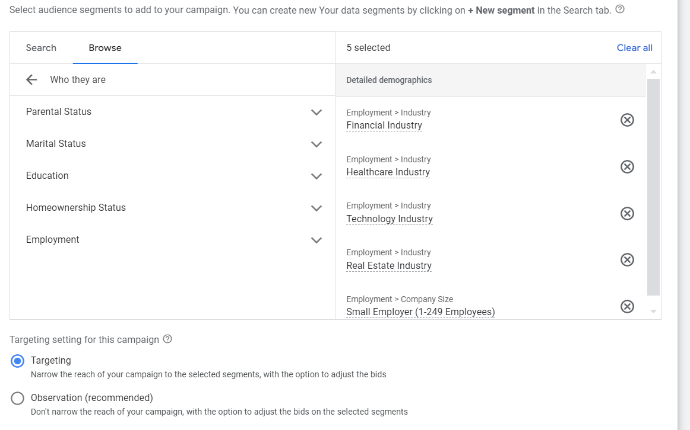
SEM- Google Ads

Slide 31
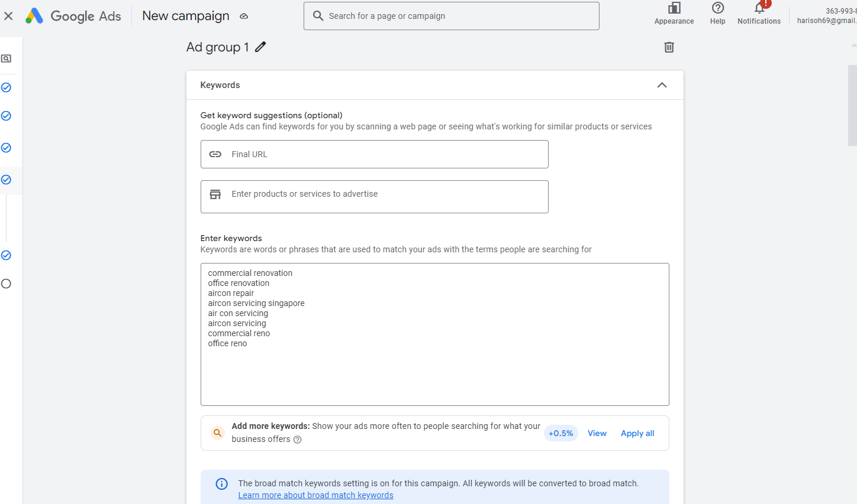
Keywords Setup

Slide 32
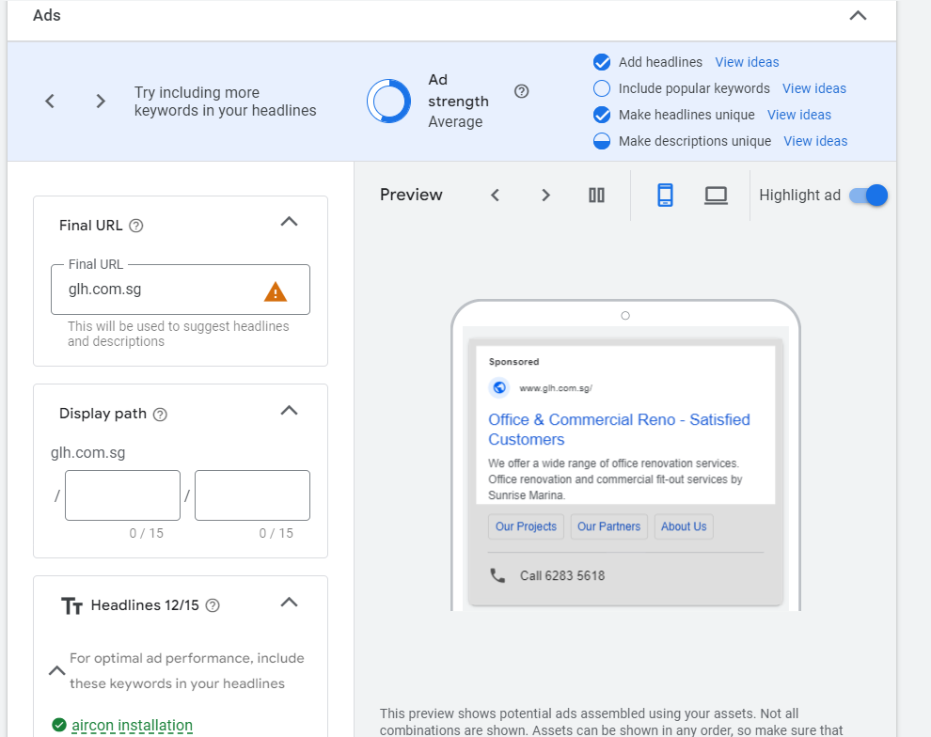

Slide 33
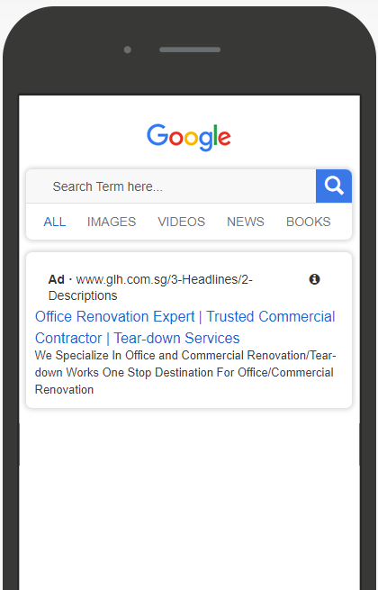
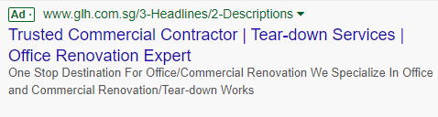
Preview of the Google Ads

Slide 34
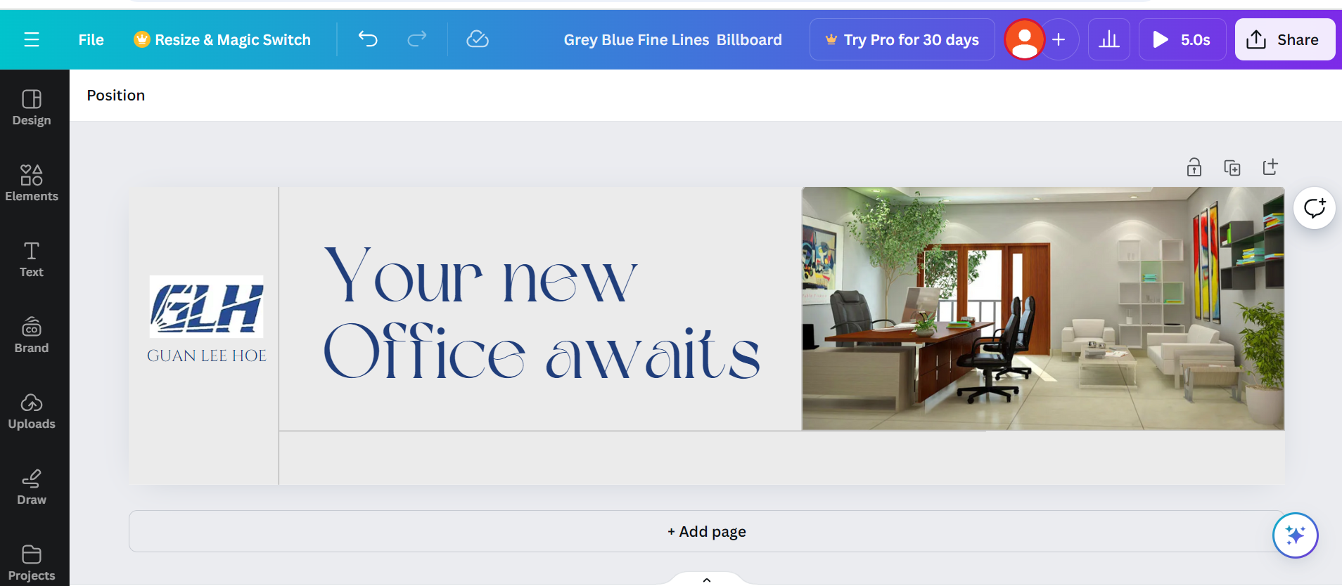
Google Display Ad Billboard

Slide 35
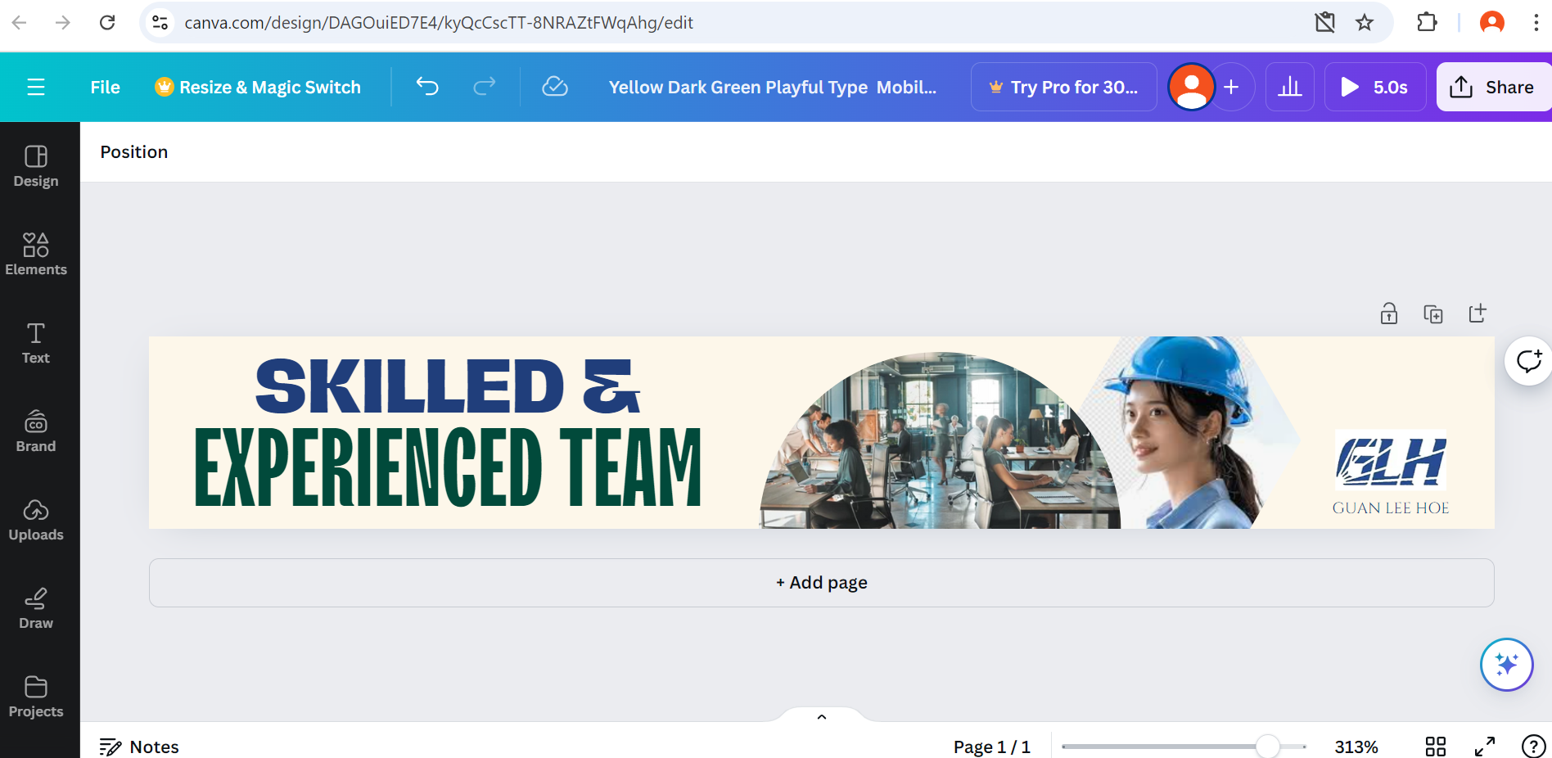
Google Ads Mobile Banner

Slide 36
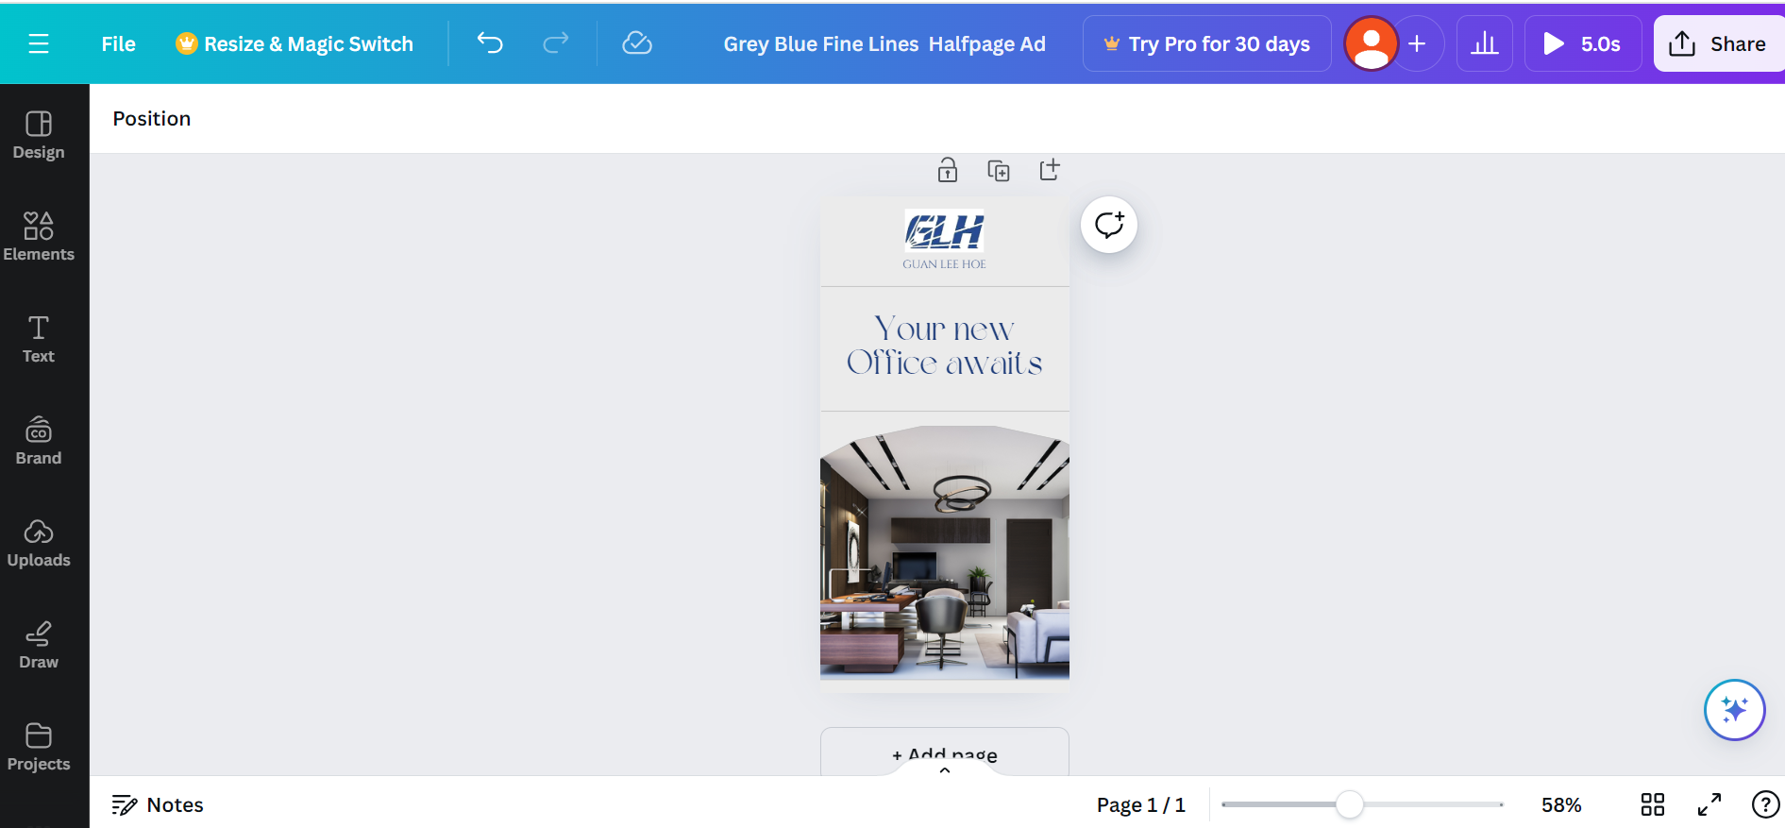
Google Display Halfpage Ad

Slide 37
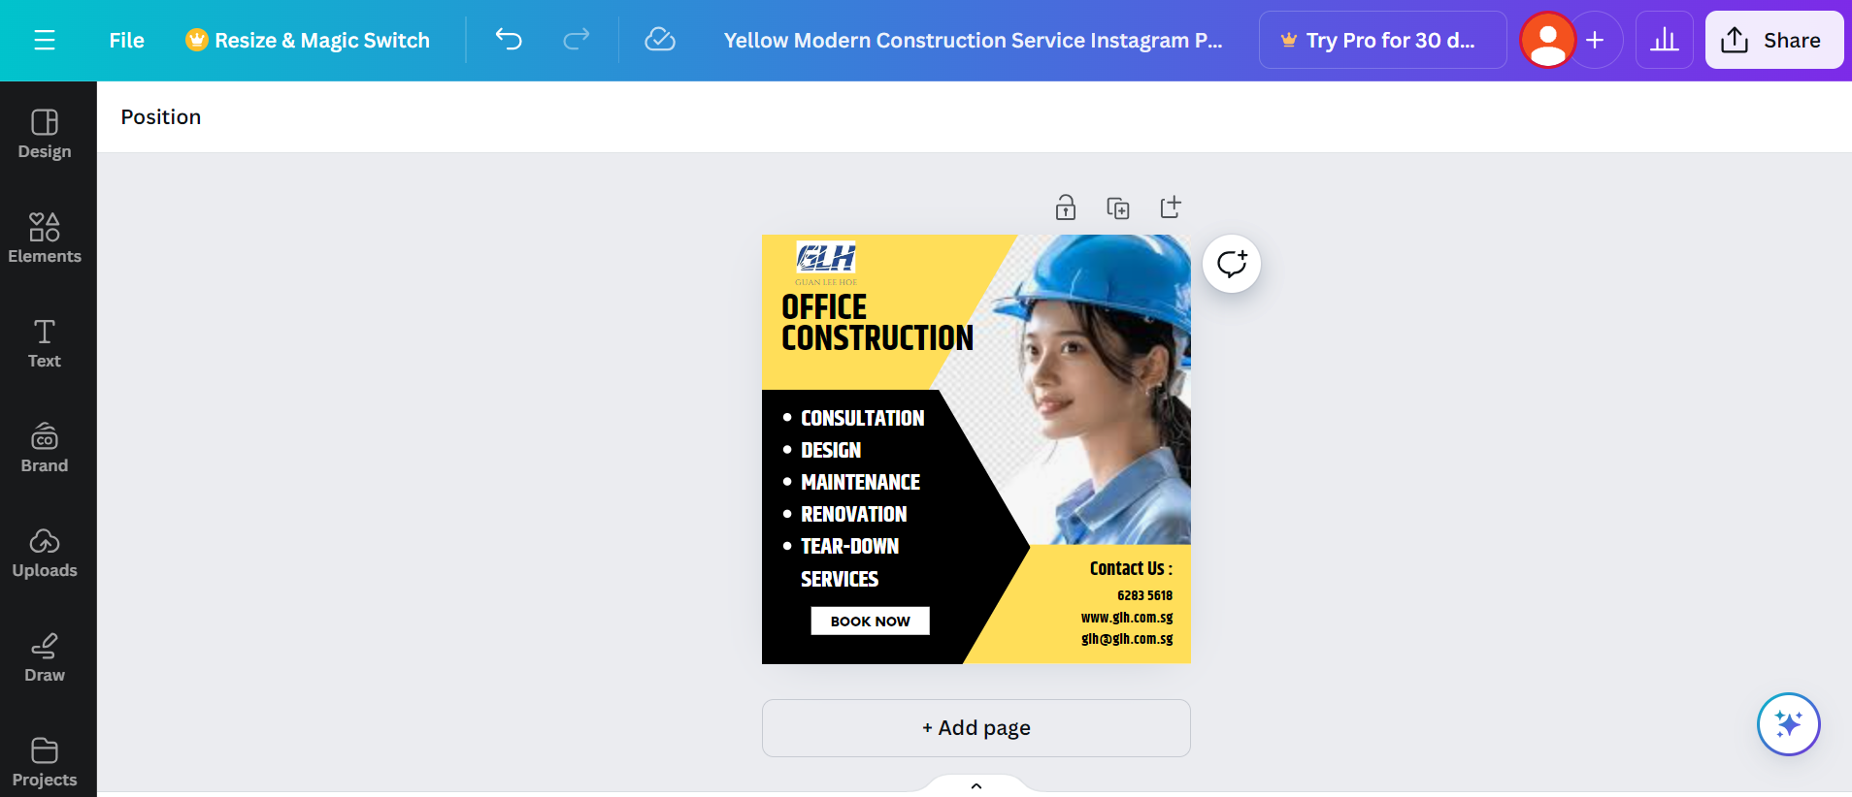
Designing Of Facebook Post

Slide 38
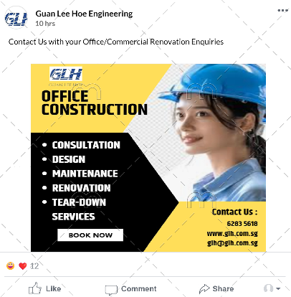
Mock Up Of Facebook Post

Slide 39
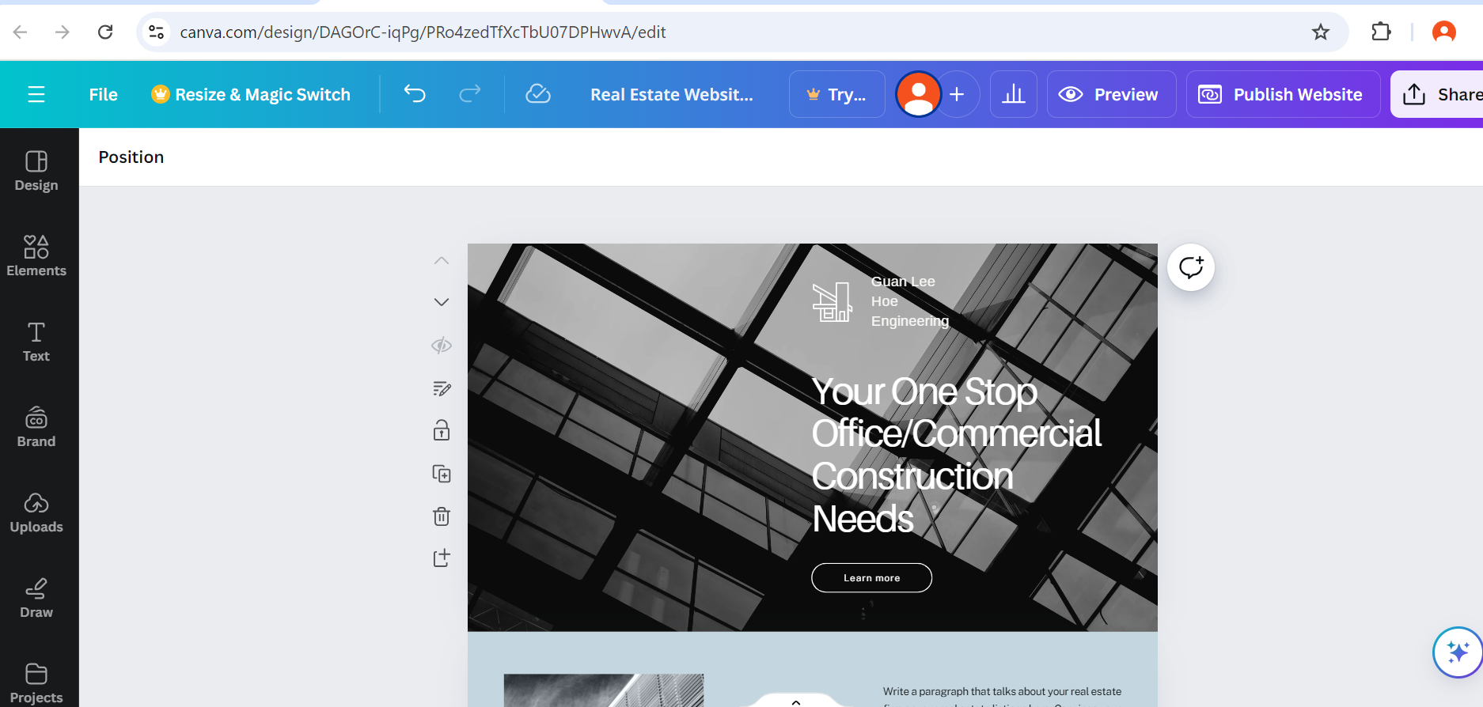
Mock Up Landing Page

Slide 40
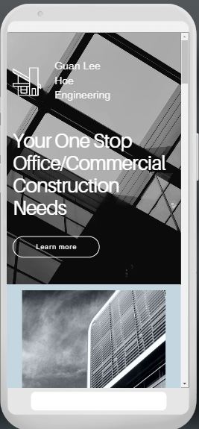
Landing Page - Mobile

Slide 41
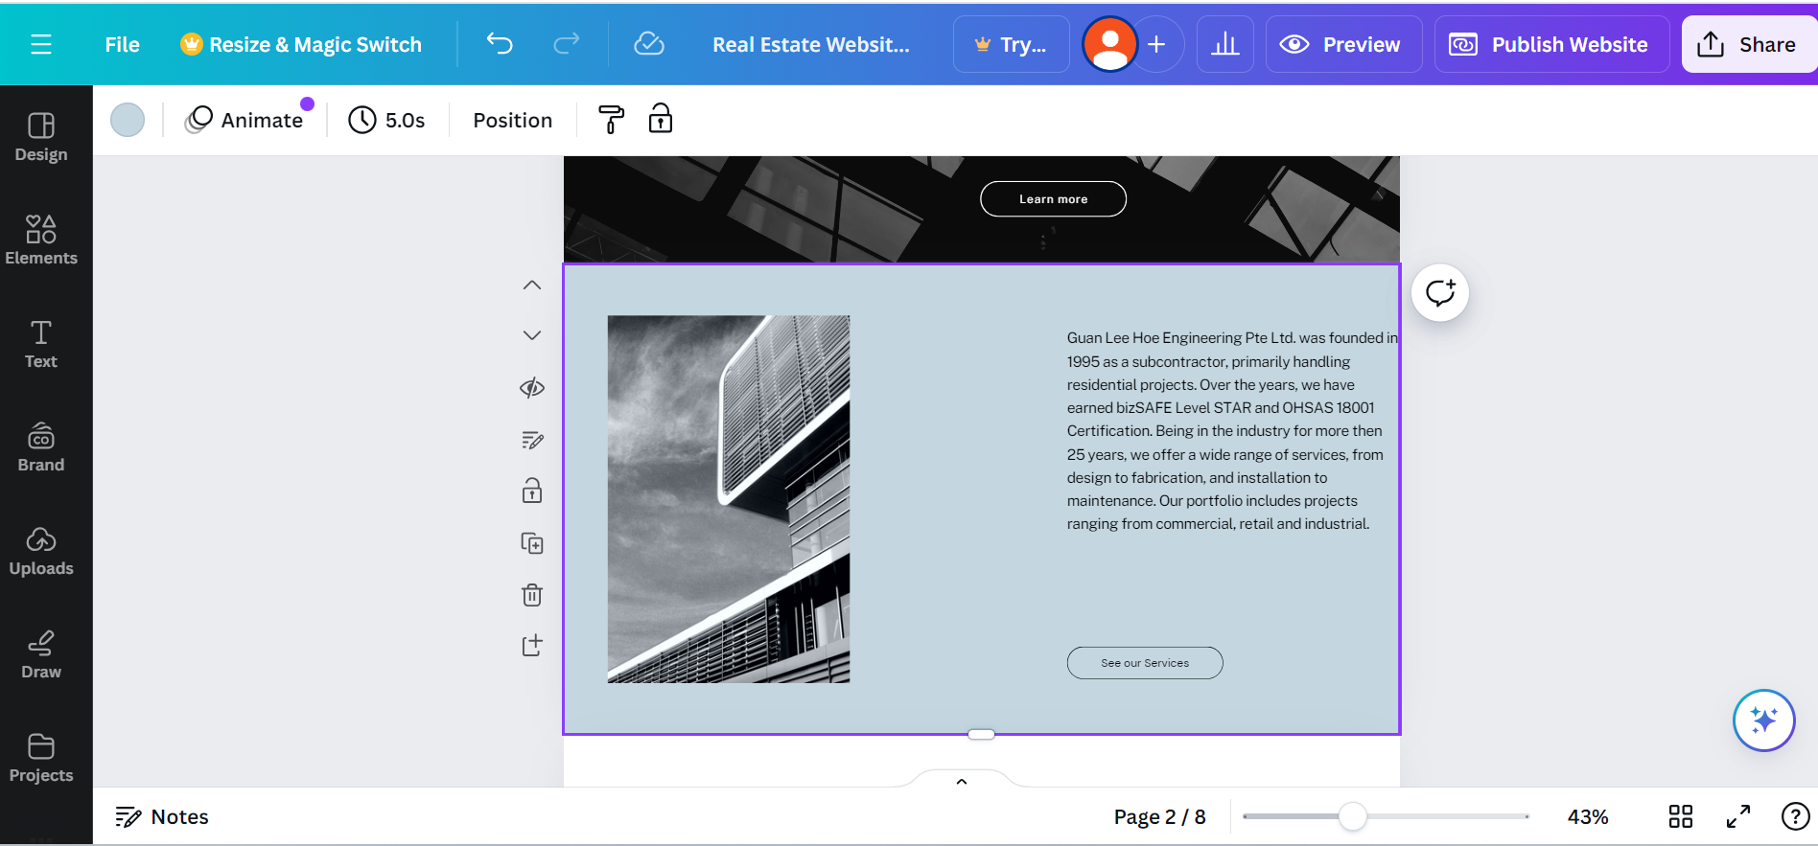
Mock Up Landing Page(About Us)

Slide 42
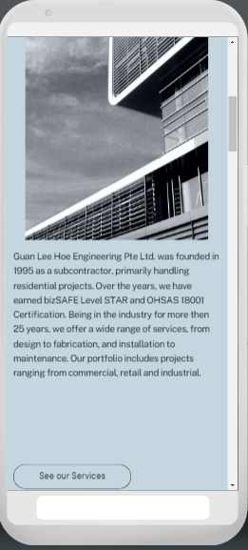
Landing Page - Mobile

Slide 43
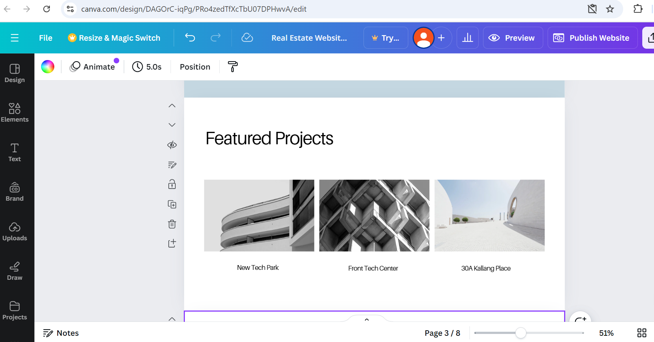
Mock Up Landing Page(Featured Projects)

Slide 44
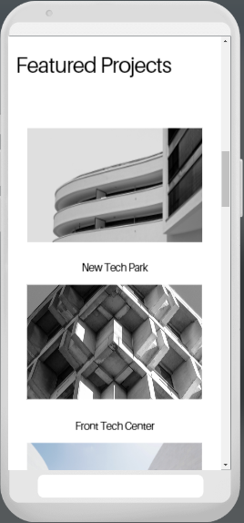
Landing Page - Mobile

Slide 45
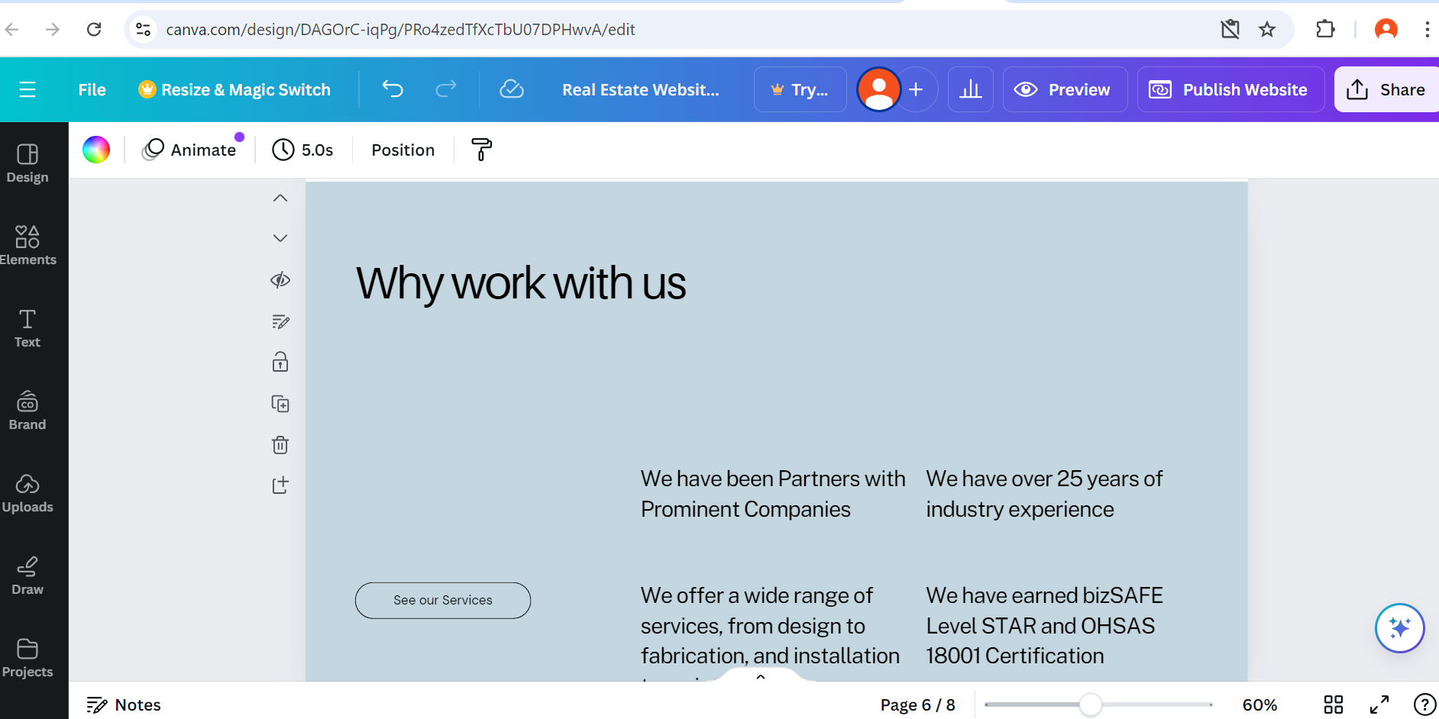
Mock Up Landing Page(Why Work With Us)

Slide 46
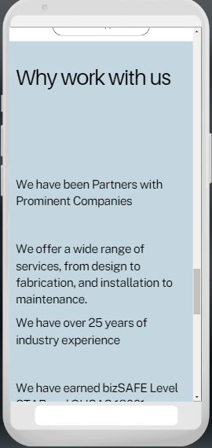
Landing Page - Mobile

Slide 47
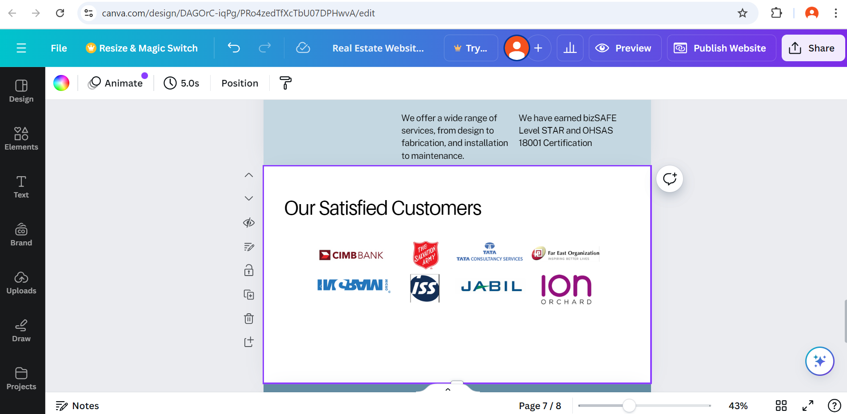
Mock Up Landing Page(Prominent Customers)

Slide 48
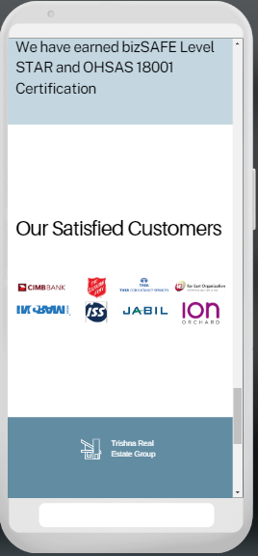
Landing Page - Mobile

Slide 49

Thank You
Md Haris Idris
+65 9753 6297
Harisoh@hotmail.com

